Slide 1
Data Analysis in Big Data
Stream Processing

Slide 2
Data Analysis in Big Data
Stream Processing
Presentation
History
Traditional Infrastructure
Lambda Architecture
Hadoop
Apache Spark
Kappa Architecture
Apache Kafka
Apache Flink
Twitter: Lambda
Twitter: Kappa
Lambda vs Kappa

Slide 3
History
Different Architectures and Frameworks

Slide 4
Traditional Infrastructure
Introduction to OLTP and OLAP
OLTP and OLAP are traditional infrastructures for managing data.
OLTP and OLAP can be combined as one system.
Producer is generating data.
Event is triggering the process (interaction).
Consumer is receiving data.

Slide 5
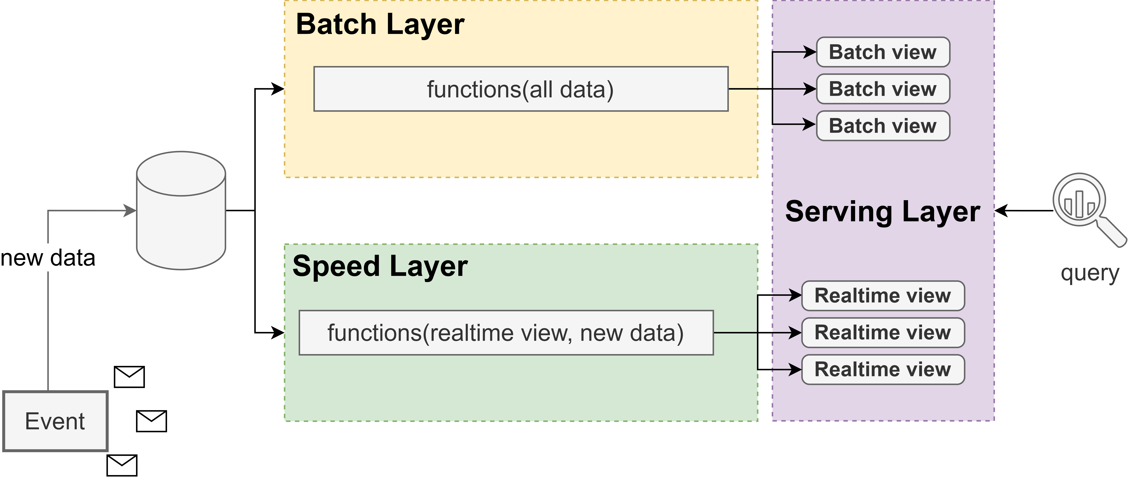
Lambda Architecture
Layout
Lambda architecture can be represented as a three-layer system.
Batch Layer processes all the data and calculates precise results.
Speed Layer continuously processes newly incoming data while the Batch Layer is still in progress.
Serving Layer combines batch and speed layers. Allows query historical and current data.

Slide 6
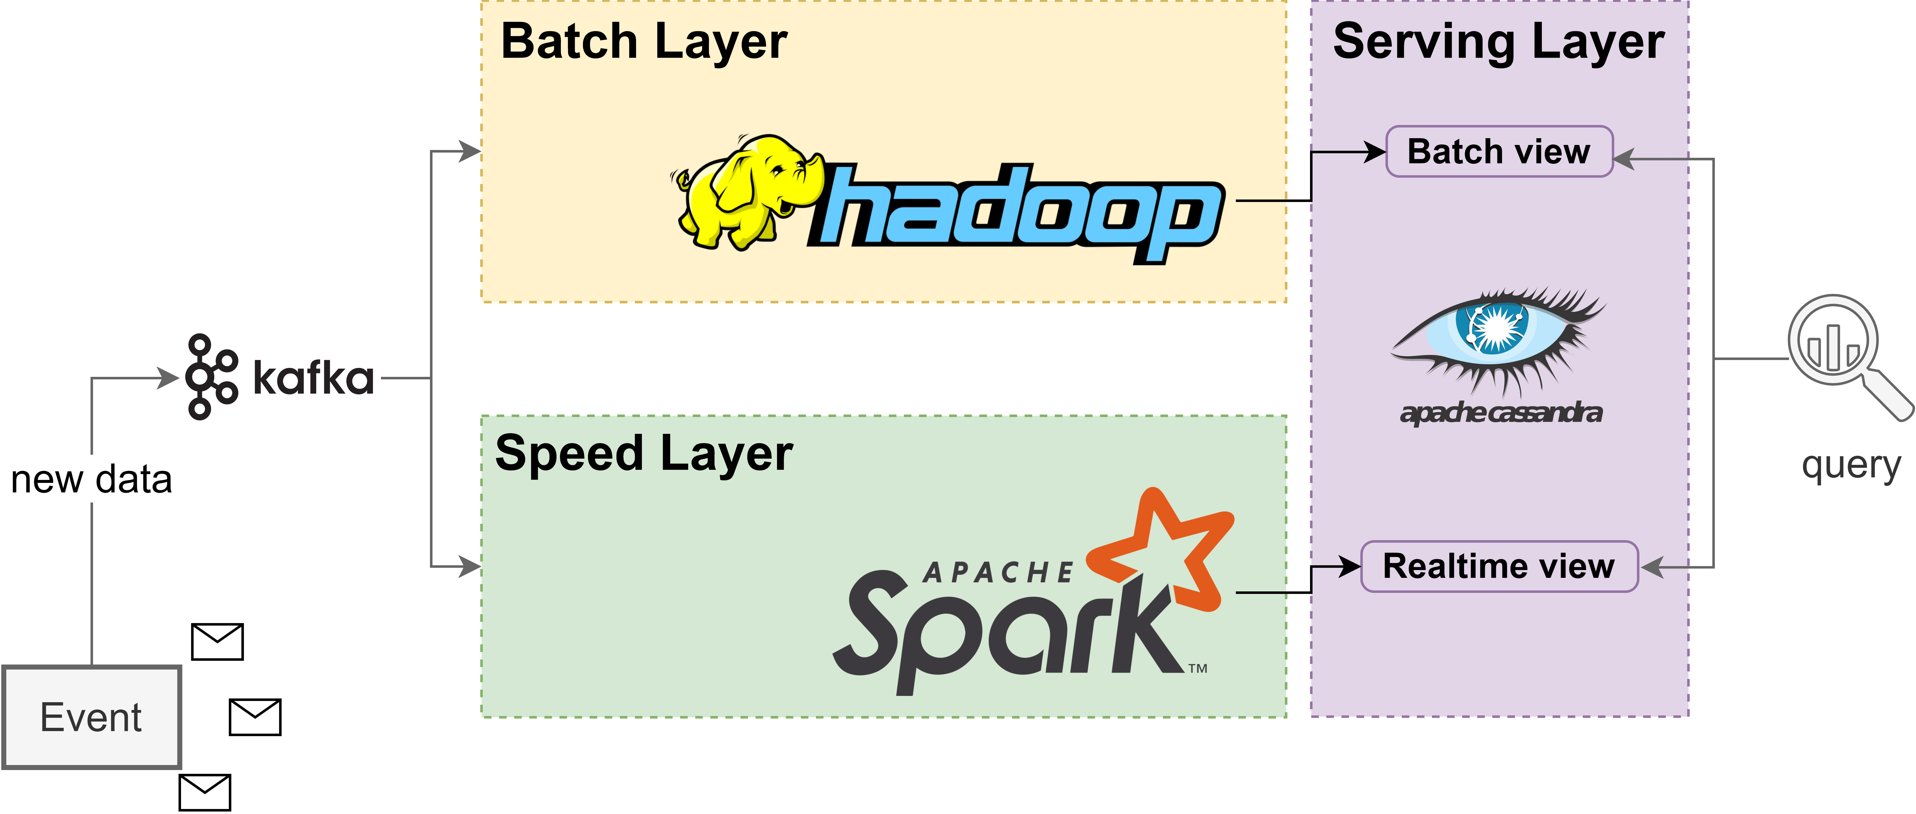
Lambda Architecture
Example
Kafka is processing all the events.
Hadoop is used in the Batch Layer and uses HDFS to store the data and MapReduce for batch processing.
Apache Spark is utilized in the Speed Layer and process and analyze new data in real-time.
Apache Cassandra is used in the Serving Layer and is a distributed NoSQL database, that can store both historical batch data and real-time data enabling fast queries.

Slide 7
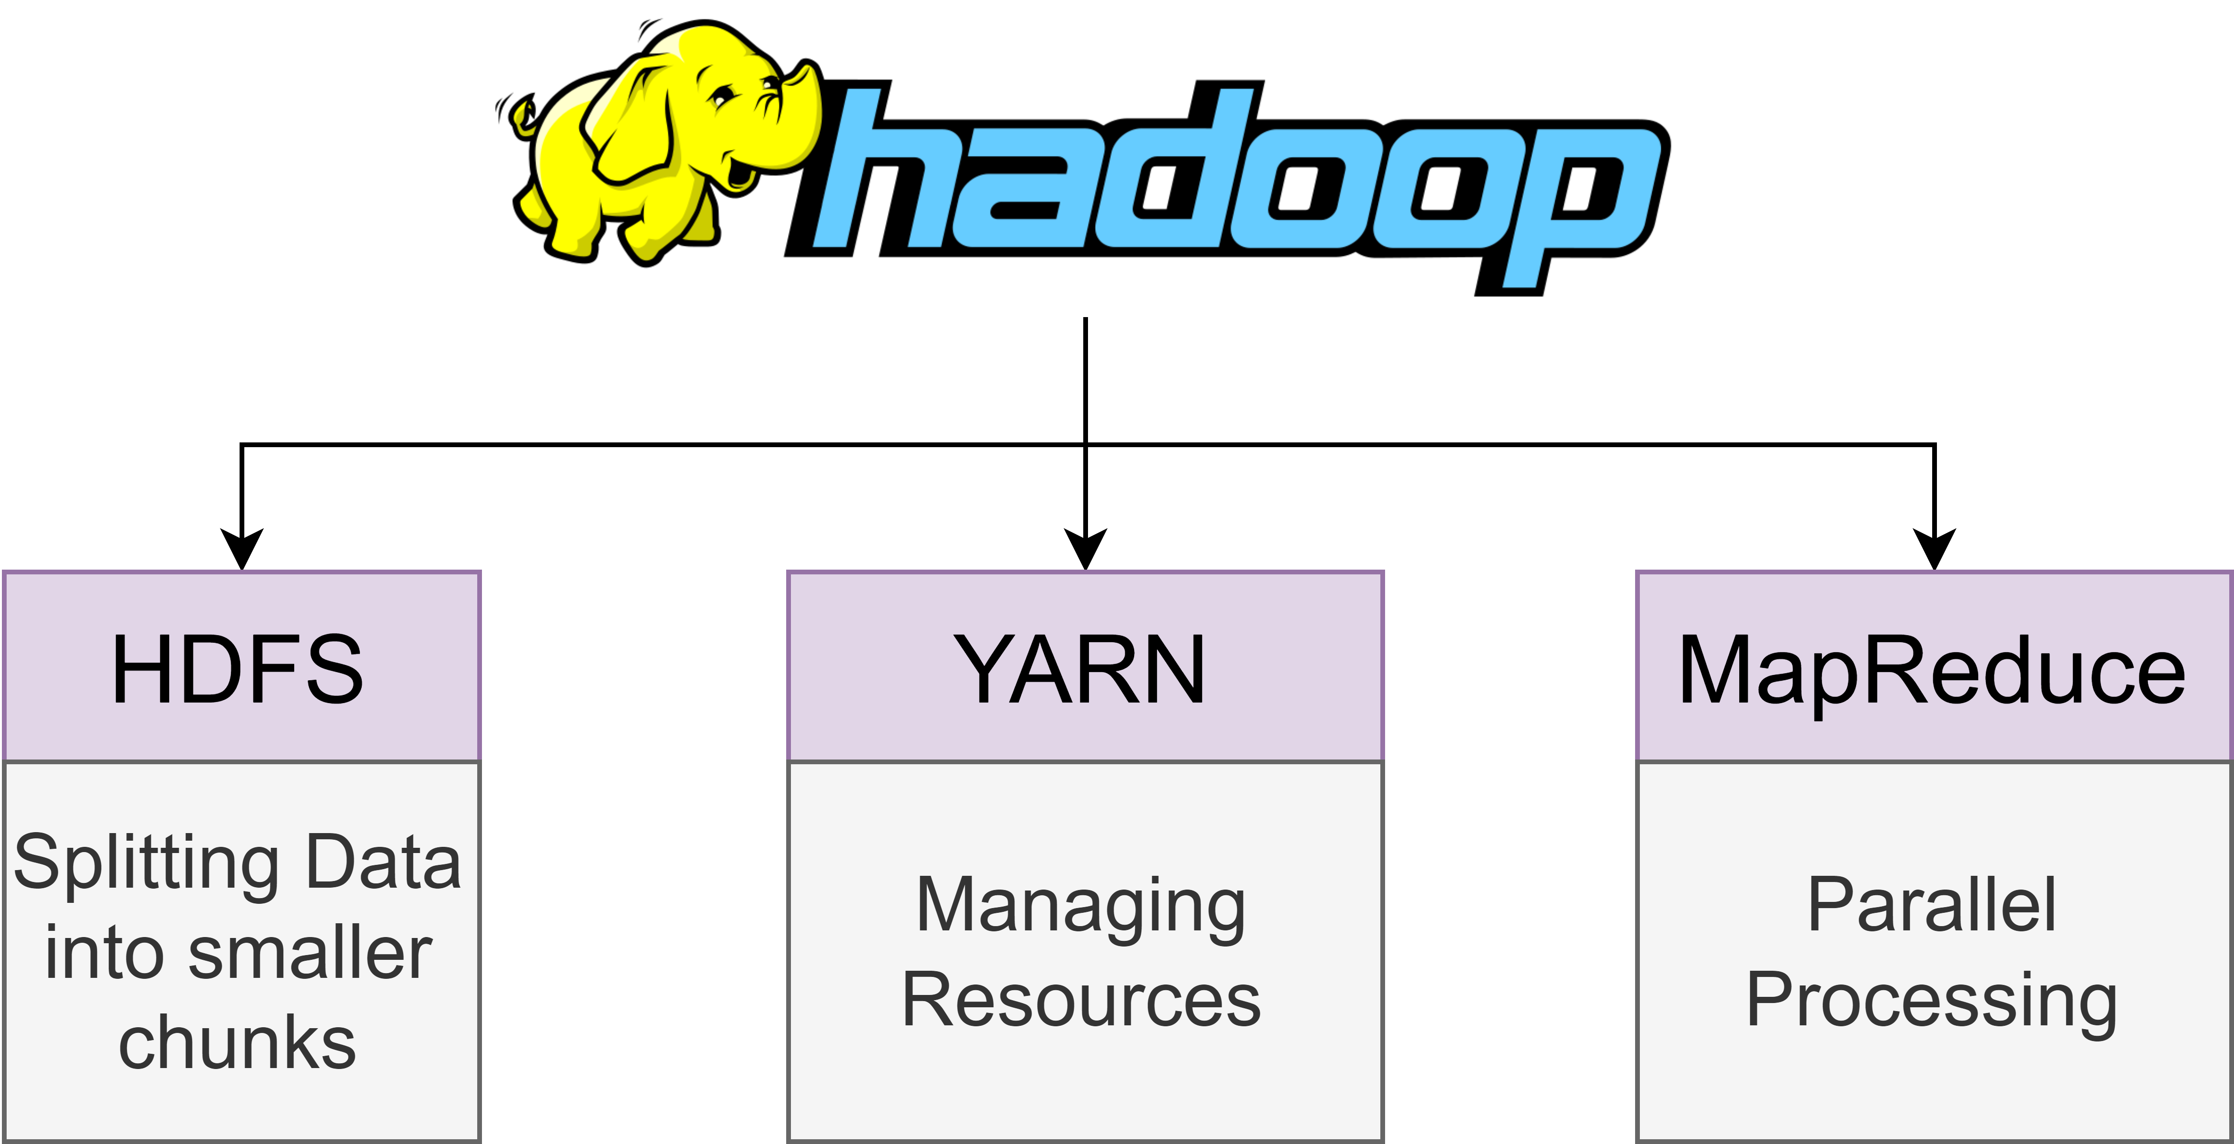
Hadoop
Overview
Hadoop is a framework that is made for distributed processing of large data sets.
Hadoop uses clusters of computers for processing and storing.
The most important modules are HDFS, YARN and MapReduce.
HDFS (Distributed File System) is a distributed file system.
YARN (Yet Another Resource Negotiator) is made for job scheduling and resource management.
MapReduce is a YARN-based system for parallel processing of large data sets.

Slide 8
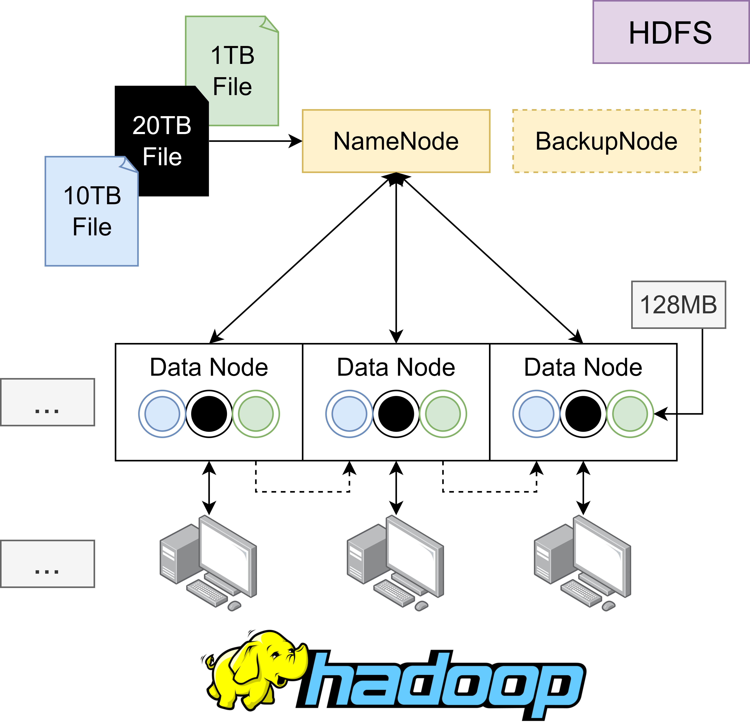
Hadoop
HDFS Concept
The Concept of HDFS is to split data sets into small chunks within a cluster.
A NameNode (Coordinator Node) is responsible for allocation and management of this divided chunks.
Every NameNode got a BackupNode.
A Data Node is a block of different datasets within a cluster.
A Data Node stores a part of whole datasets and is usually divided into 128MB chunks.
Every Data Node got usually three replicas to ensure integrity and fault tolerance.
A Consumer is always communicating with the NameNode for reading or writing data.

Slide 9
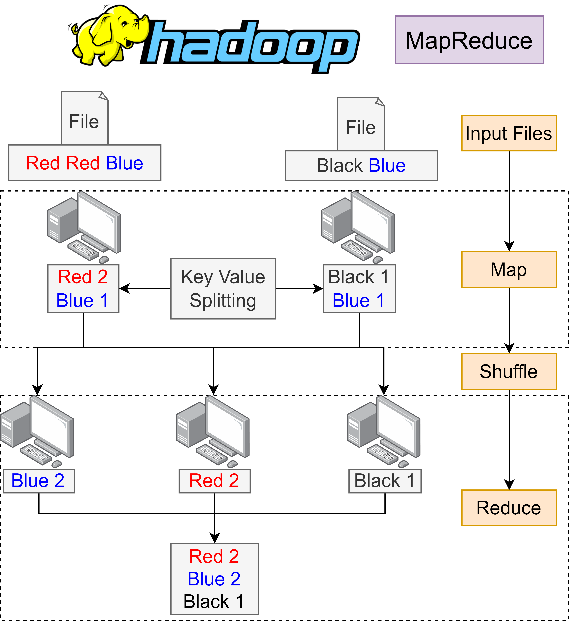
Hadoop
MapReduce
MapReduce is used for processing large data sets using Map, Shuffle and Reduce phases.
Map Phase divides data into key-value pairs and process each pair independently by categorizing or applying specific computations.
Shuffle Phase reorganization and redistribution of the key-value pairs generated in the Map Phase. This ensures that all values for a particular key are grouped together and sent to the same Reducer.
Reduce Phase operates on each group of key-values, possibly combining or summarizing them to produce the final output.

Slide 10
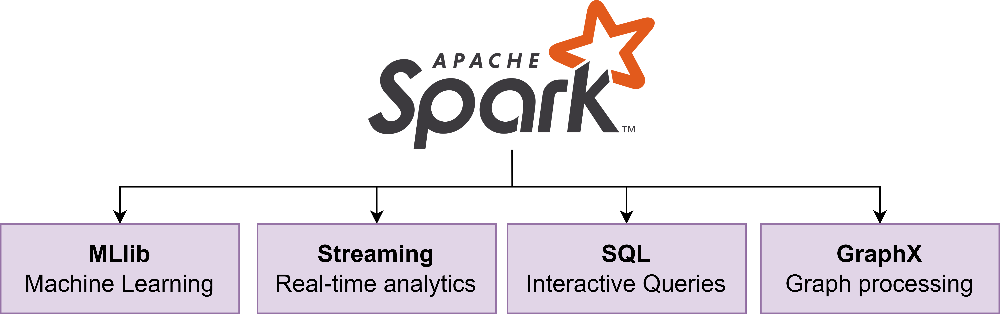
Apache Spark
Overview
Apache Spark is a framework for data science, machine learning and data engineering on single-node machines or clusters.
Key modules of Apache Spark are MLlib (Machine Learning Library), Streaming for processing real-time data, SQL analytics and GraphX for visualization.

Slide 11
Apache Spark
Structured Streaming
Structured Streaming is a scalable and fault tolerant stream processing module.
Data streams in Structured Streaming are represented as unbounded tables with new data being treated as incoming rows.
Structured Streaming manages late incoming data efficiently by managing and processing it appropriately.

Slide 12


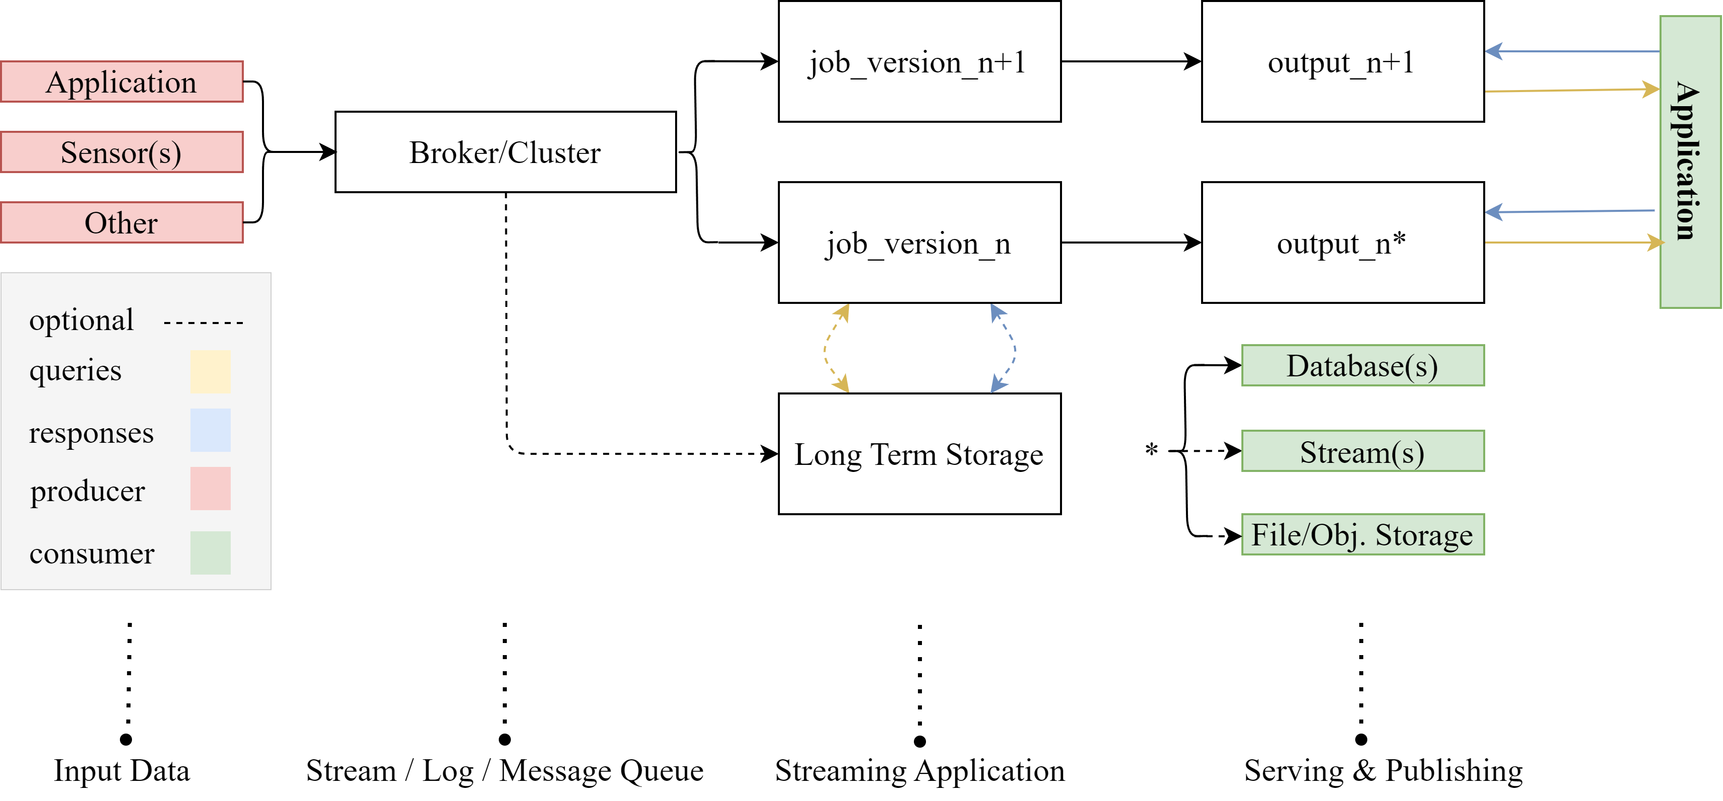
Kappa Architecture
Everything is a stream!

Slide 13
Kappa Architecture
Insights
In comparison to Lambda, Kappa handles all data as a single data stream, which simplifies the whole pipeline and reduces overall complexity.
Kappa assumes, that incoming logs are immutable, which important for data reprocessing by new changes to your stream processing frameworks.
Kappa, by its design, is great scalable and ensures fault tolerance when it is used in couple with Apache Kafka.
Single speed layer requires resources for continuous processing, often leading to increased costs.
The architecture has problems with handling late-arriving data. So, to update historical results an entire data stream should be reprocessed.

Slide 14
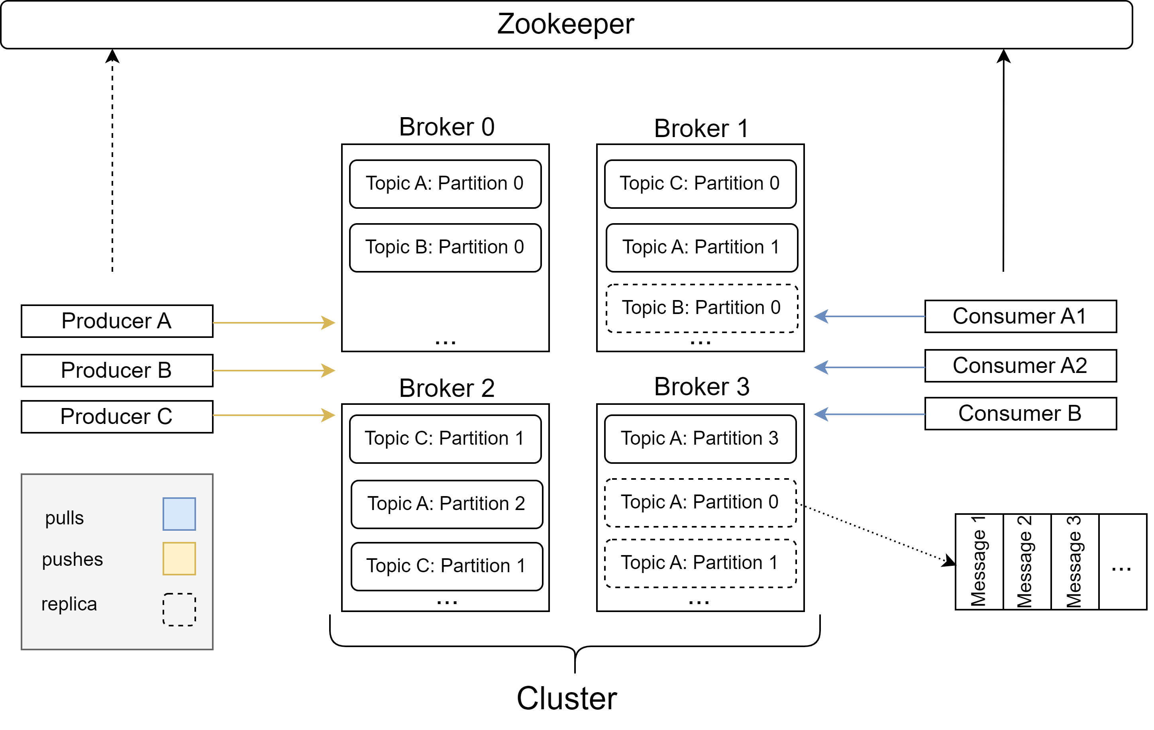
Introduction to Apache Kafka
De Facto Standard API for Event Streaming

Slide 15
Apache Kafka
Insights
Kafka is an open-source, distributed streaming platform for real-time data pipelines.
The application uses publish-subscribe messaging model, meaning Kafka publishes messages to topics and consumers have pull newcoming event for further processing. The decoupling of consumer and producers provides better flexibility and independent scalability.
Apache Kafka ensures no data-loss by adjustable fault tolerance via events replication across multiple Kafka nodes.
Since Kafka is widely used, it supports various scenarios and enables to be built-in in almost every data processing pipeline.

Slide 16
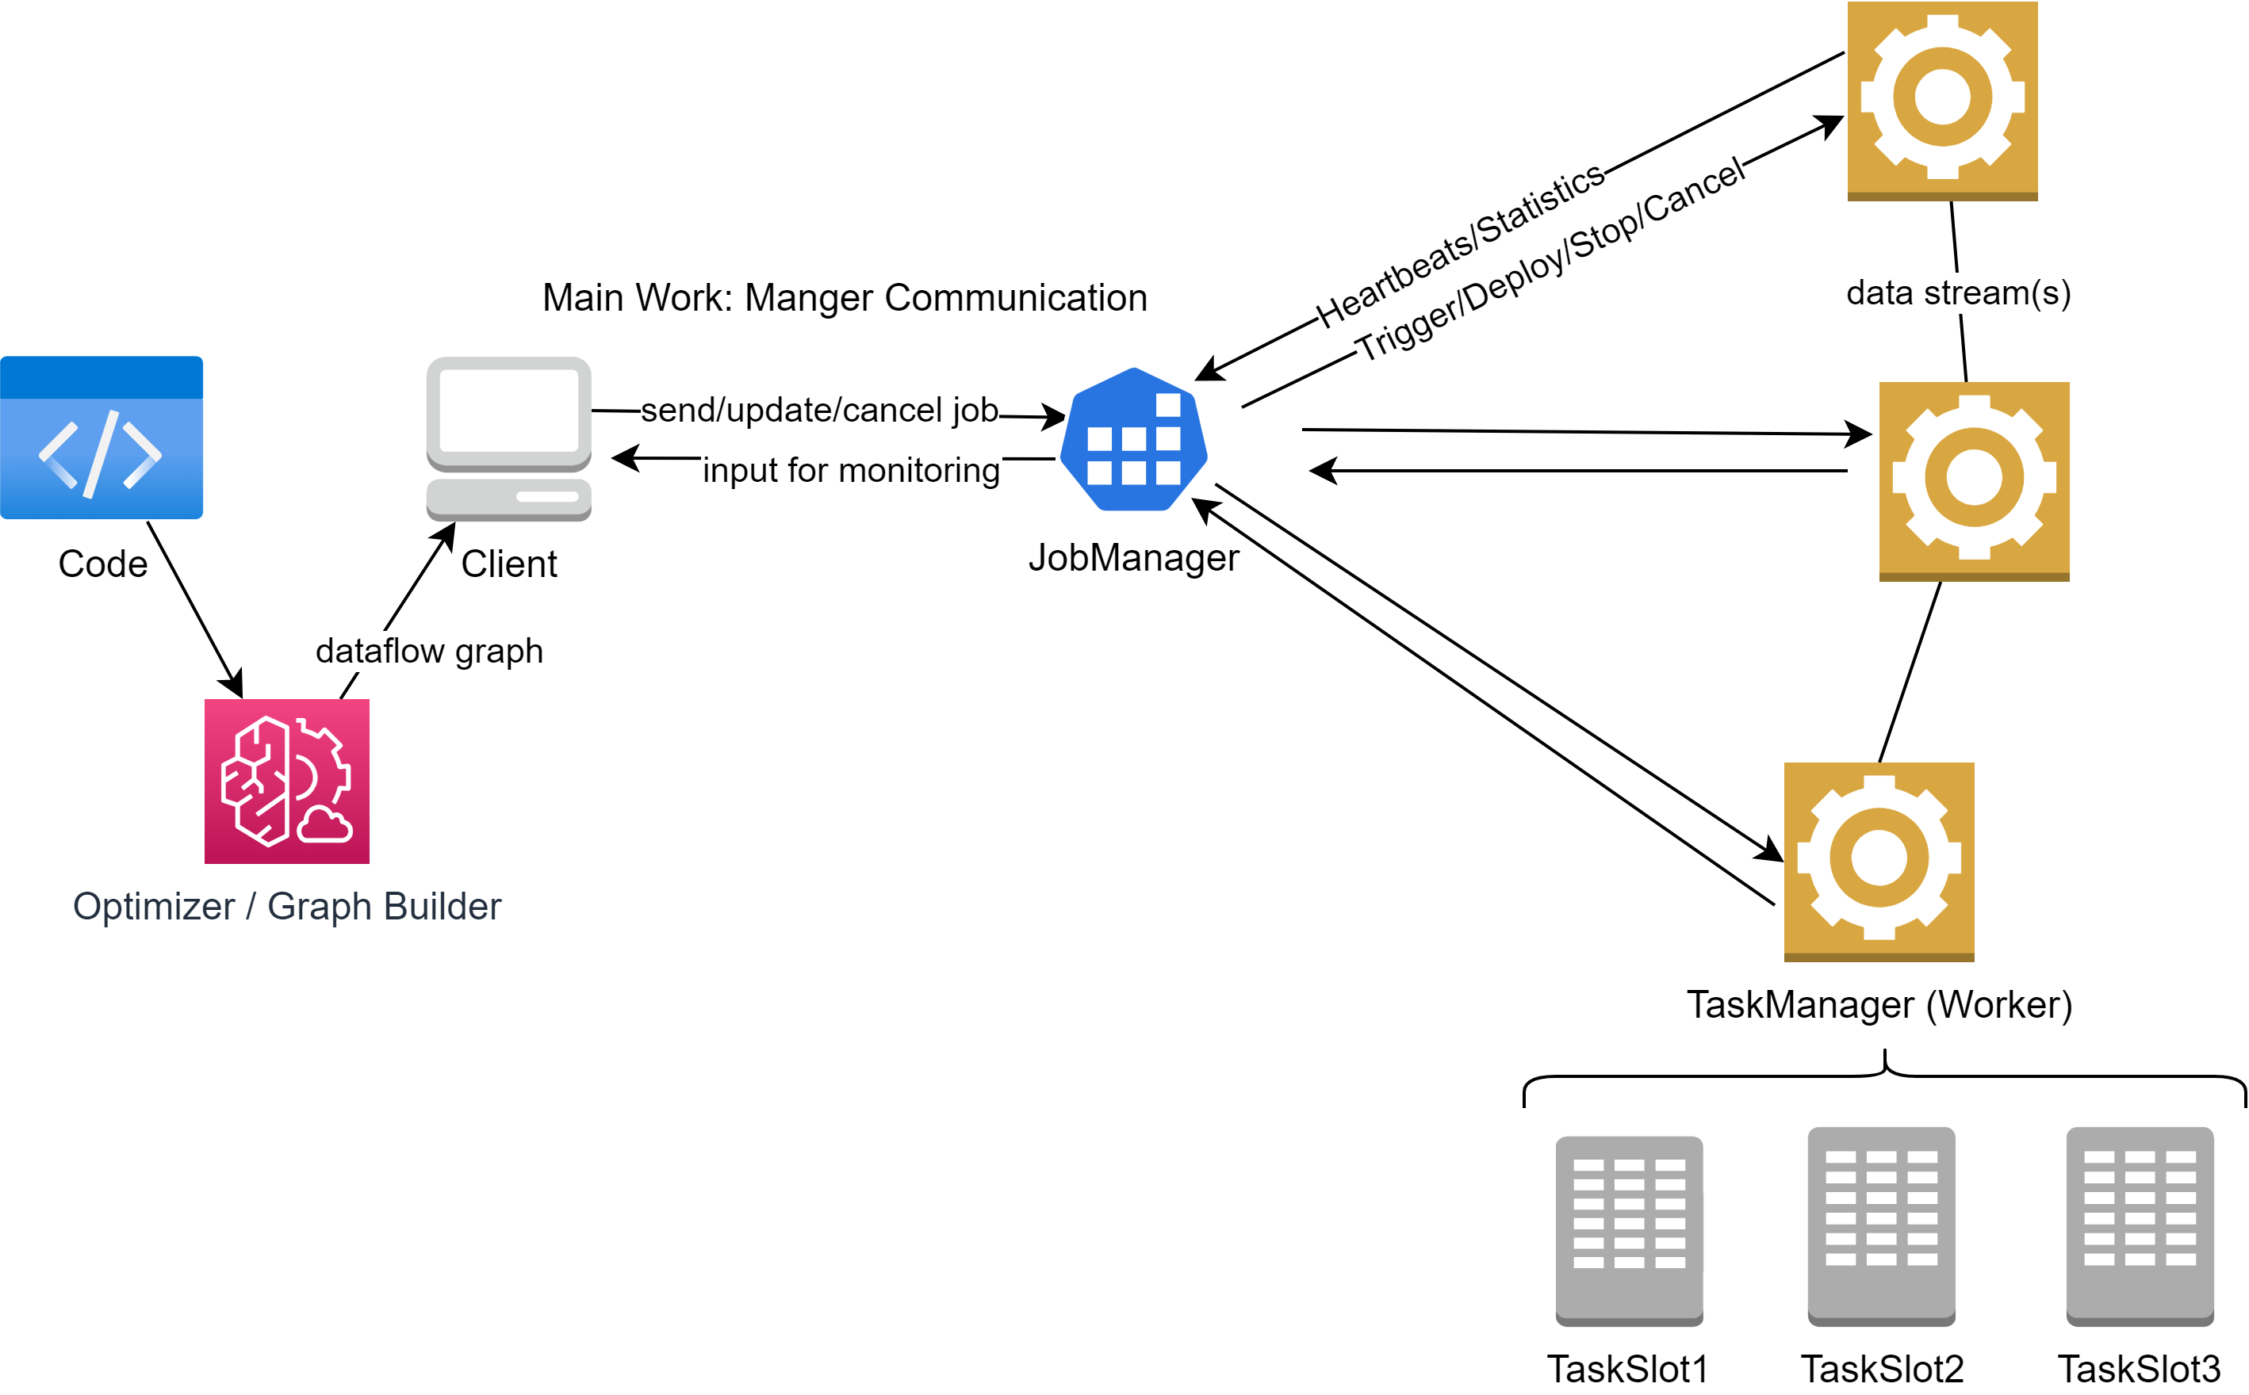
Apache Flink
Stateful Computations over Data Streams

Slide 17
Apache Flink
Insights
Apache Flink supports real-time even processing, which also supports handling of delayed or out-of-order events.
Flink processes mainly data as streams without cutting data to microbatches, as it is made by Apache Spark. So that increases data throughput and lowering the system latency.
The framework ensures Exactly-Once-Processing, avoiding data duplication or losses. By high data volumes, it allows to decrease event computation cost for the sake of money saving.
The tool automatically manages memory without unnecessary data shuffling, leading to better overall performance and saving the available resources.
Apache Flink can be easily integrated with every other tool, provided by the Apache ecosystem.

Slide 18
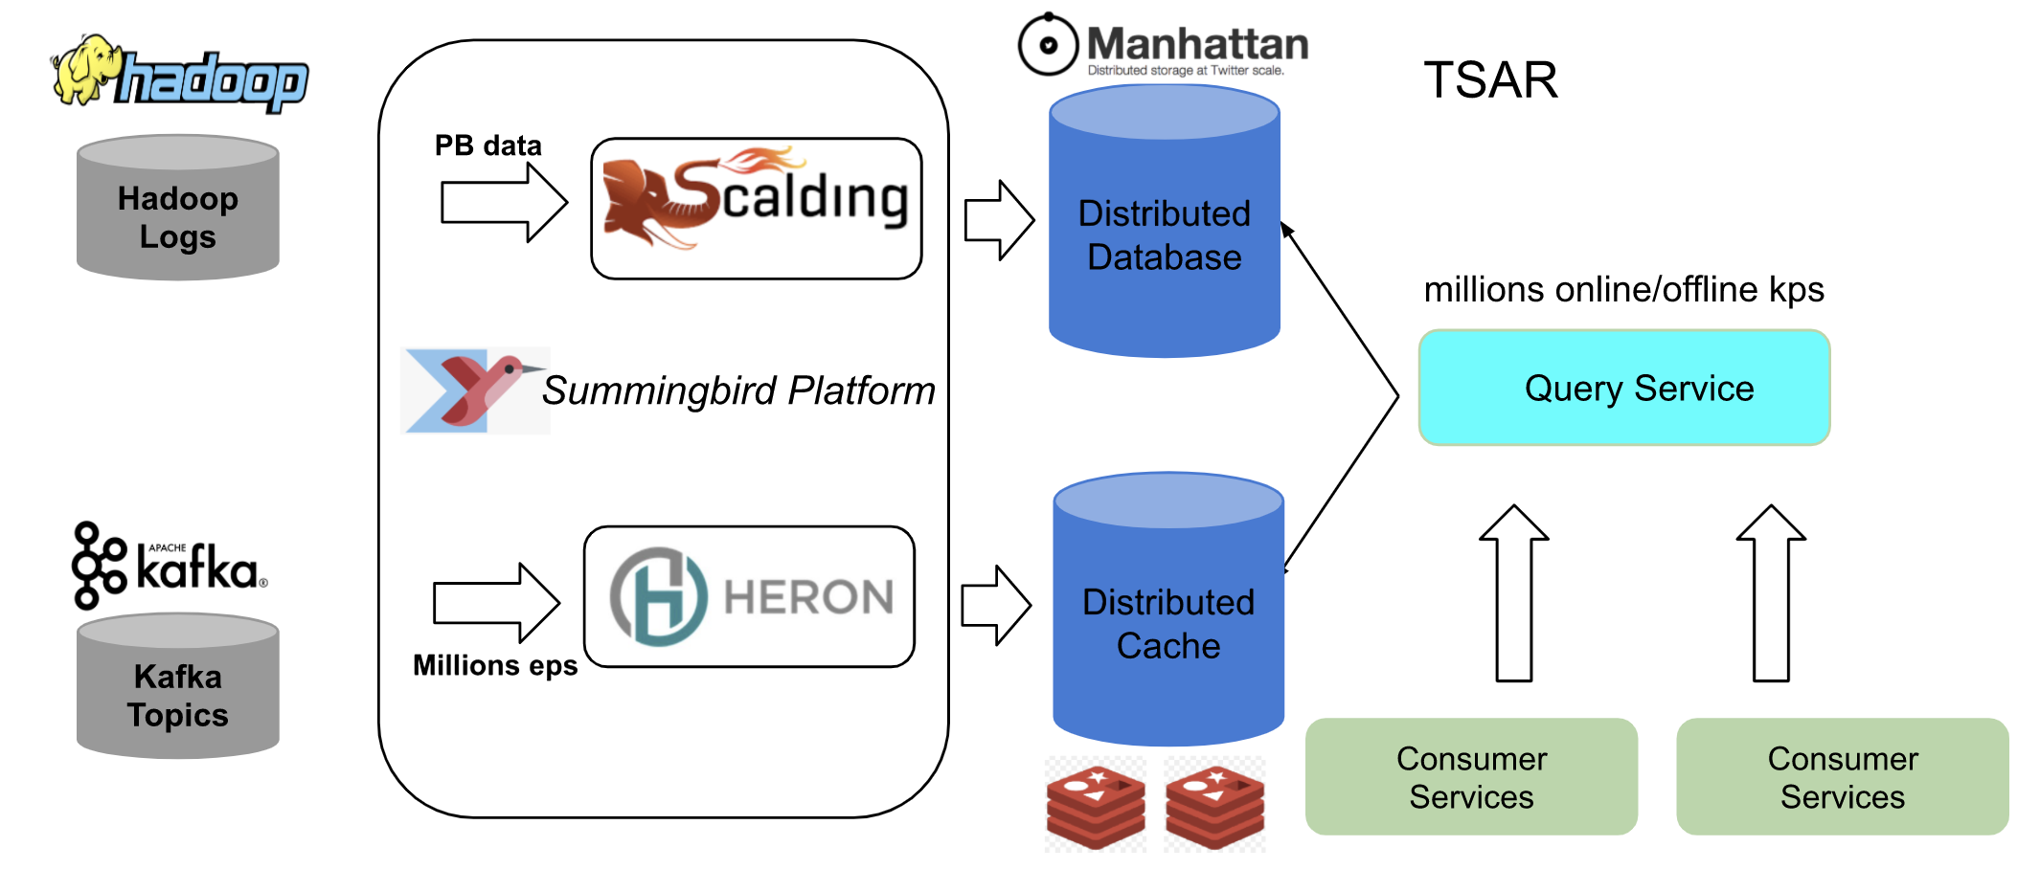
Real Case Study: Twitter
Before: Lambda
Batch layer
Speed layer

Slide 19
Real Case Study: Twitter
Lambda Insights
Summingbird provides high-level language, eliminating the problem of parallel maintainance Lambda layers.
Twitter Service Auto-Scaling Rules (TSAR) manages services’ auto-scaling. It adjusts the number of instances running for a particular service based on real-time demand. Also, merges produced data by both layers.
Batch processing costs are reduced by centralizing the computing on one data center and replicas distribution to others.
Arising streaming volumes led to the data losses in the Speed Layer, which resulted into less accurate aggregated data shown to Twitter users.

Slide 20
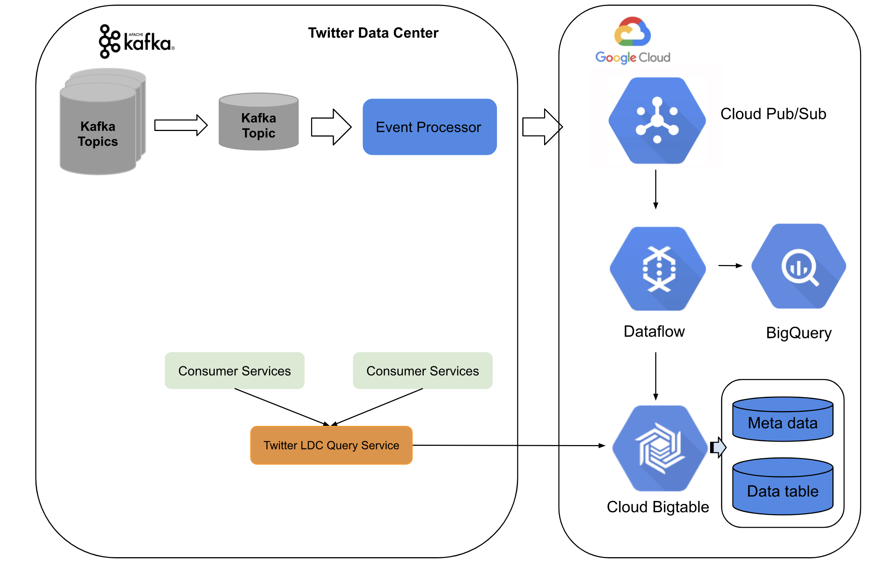
Real Case Study: Twitter
After: Kappa

Slide 21
Real Case Study: Twitter
Kappa Insights
During the whole data pipeline, Twitter ensures that all message are delivered, by using at-least-once semantics.
Before transferring to the cloud, the pipeline makes data preprocessing and optimizes Kafka logs for a Pubsub topic for reducing data storage.
To achieve near exactly-once processing, Twitter applies internal deduping strategies within a timed window. The deduplication is made by Dataflow workers via UUID assigned by the Event Processor.
Distributed aggregation of real-time data over Dataflow and BigQuery provides low-latency and high streaming throughput.
On-premise Twitter query services tap the data from the high-scalable and distributed storage system for structured data.

Slide 22

Lambda vs Kappa
Compare
 | Lambda | Kappa
Cost
Implementation
Robustness (fault tolerance)
Troubleshooting
Resources
Size of Dataflow
Scalability (difficulty)
Complexity of calculation
Consumer Requirements | Precise Results | Live Data
Necessity of historical data | Yes | No
Type of Machine Learning | Supervised (historical needed) | Unsupervised and semi-supervised

Slide 23
Literature
Seite 1/1
1. Hueske, F., & Kalavri, V. (2019). Stream Processing with Apache Flink Fundamentals, Implementation, and Operation of Streaming Applications. O’Reilly Media.
2. Feick, Martin, Niko Kleer, and Marek Kohn. "Fundamentals of real-time data processing architectures lambda and kappa.“
3. Owczarek. “Lambda vs. Kappa Architecture.” URL: https://nexocode.com/blog/posts/lambda-vs-kappa-architecture/
4. Garg, Nishant. Apache kafka. Birmingham, UK: Packt Publishing, 2013.
5. Twitter Blog: https://blog.twitter.com/engineering/en_us/topics/infrastructure/2021/processing-billions-of-events-in-real-time-at-twitter-
6. Apache Flink Documentation: https://nightlies.apache.org/flink/flink-docs-release-1.16/docs/concepts/flink-architecture/
7. Kleppmann, M. (2017). Designing Data-Intensive Applications: The Big Ideas Behind Reliable, Scalable, and Maintainable Systems. O’Reilly Media
8. Hueske, F., & Kalavri, V. (2019). Stream Processing with Apache Flink Fundamentals, Implementation, and Operation of Streaming Applications. O’Reilly Media.
9. Akidau, T., Chernyak, S., & Lax, R. (2018). Streaming Systems. O’Reilly Media.
10. Online: Apache Software Foundation Projects https://projects.apache.org/
11. Marz, N. (2015). Big Data. Manning.
12. Achari, S. (2015). Hadoop Essentials. Packt Publishing, Limited.
13. Online: Apache Spark Documentation https://spark.apache.org/docs/latest/structured-streaming-programming-guide.html
14. Chang, Dean (2006). Bigtable: A Distributed Storage System for Structured Data. 7th USENIX Symposium on Operating Systems Design and Implementation (OSDI)
15. Hadoop Documentation: https://hadoop.apache.org/
16. Apache Spark Documentation: https://spark.apache.org/

